Slide 1
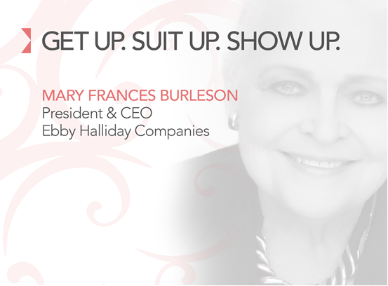
April 3, 2013

Slide 2

Introductions
Overview
Do you ever feel like this?

Slide 3

Ebby Halliday, REALTORS
Founded in 1945, by Ebby Halliday, a single young woman
30 offices, 2 real estate brands
2012 participated in 15,916 transactions, with sales volume of $4.799 billion

Slide 4

Dallas Business Journal

Slide 5



12,000 square miles
  Sherman/Oklahoma (North)
  Tarrant County – Arlington, Fort Worth, Southlake (West)
  Rockwall (east)
  Cedar Hill/Duncanville/Midlothian (South)
Full-service, client focused
Additional Services

Slide 6
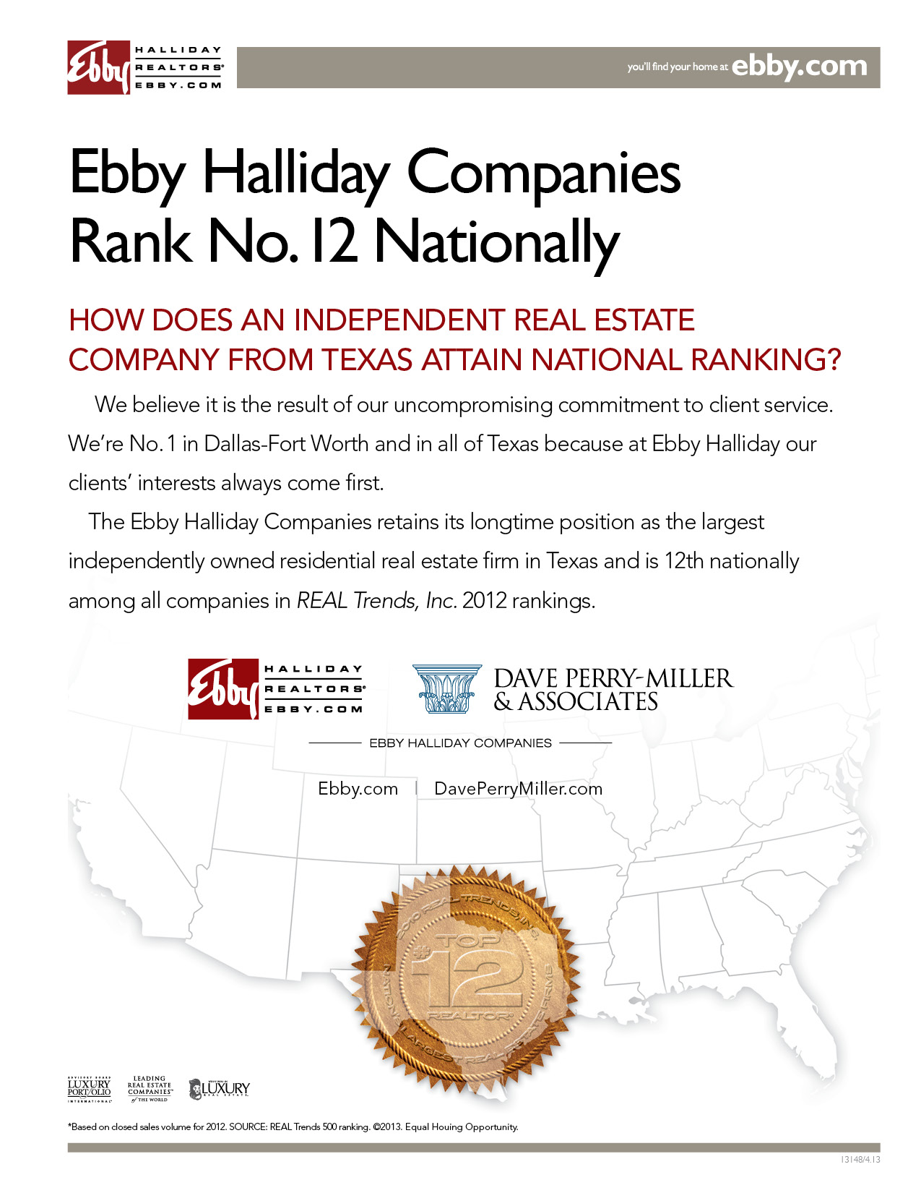

Slide 7

LOOKING OVER THE GARDEN FENCE
Background
  Kelly Girl attending SMU
  Assignment to Ebby Halliday
  Women were conducting business, managing their own day and making money!
Not many role models
  Mary Kay Ash and a few others

Slide 8
Built on a Foundation of Service & Strong Reputation of Trust
Service to the Client
Service to the Industry
Service to the Community
  A consistent focus on supporting many North Texas charitable organizations, and belonging to local chambers of commerce, promoting our local economy

Slide 9
Built on a Foundation of Service & Strong Reputation of Trust
Help others and recognize the obligation we have to pay rent for the space we take up
Protect your reputation, it can only be built with time
Reputation is one of the most important qualities for you and your company

Slide 10

Our business provides unlimited opportunities to grow personally and professionally, and philosophically
Ebby “leaned in” long before Sheryl Sandberg coined the phrase
Many good points in her book and her renowned TEDTalk
  “Sit at the table, seek challenges, take risks and pursue your goals with gusto!”
Ebby says “I acted like a lady and conducted business like a gentleman.”

Slide 11
LEADERSHIP
“ Ebby Halliday personifies the kind of leader who leads with her heart, her entrepreneurial business sense and her unflagging energy to make her dreams for herself, her company, and her community come true.”
— Roger Staubach

Slide 12
GET UP. SUIT UP.
The First step is to get up!
Get out of bed, and get going
Wake up with intent
You can decide what kind of day it will be

Slide 13
SHOW UP
Be fully present; not just in body but in mind, too
Doug Conant, former CEO of Campbell Soup says
  How can I help?
  Listen and frame the issue
  Then move it forward
You don’t have to like everyone to work with them or respect them
Look for Touch Points
  Sharing and connecting with people
      Birthday Calls
      Dog Cards
      Anniversary Cards (Personal & Business)
      Congratulations on Achievements (Personal & Business)

Slide 14
“Winning is not a sometime thing, it is an all the time thing. You don’t do things right once in a while…you do them right all the time.”
~ Vince Lombardi

Slide 15
Ebby’s Recipe for a Meaningful Life excerpted from her book
Maintain your health
Keep learning
Choose a career wisely
Learn to communicate
Build your self-confidence

Slide 16
Recipe for a Meaningful Life
Create good business habits
Observe company policies
Express gratitude by thanking people
Contribute to your community
Choose your partner carefully
Be kind
Do something for someone every day

Slide 17
Life and Business
If people like you and trust you they will do business with you
Have a strict code of ethics both personally and professionally
Stand behind your commitments and promises
Keep learning

Slide 18
Life and Business
Keep up with changes
  Laws change
  People change
  Market changes
Think how the Internet has changed Us and the World!

Slide 19
Remember…
Get Up!
Suit Up!
Show up!
And …

Slide 20
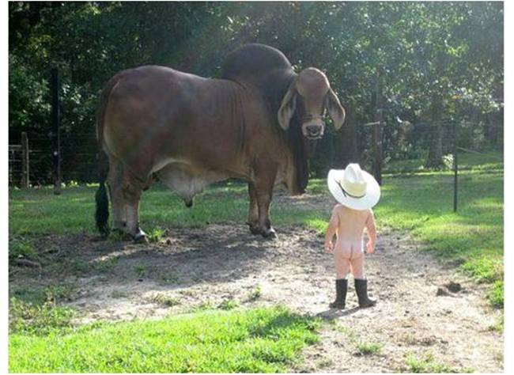
Be fearless!
Thank you!

