Slide 1
ADVANCING A BETTER ELECTRIC FUTURE
Jim Greer
Chief Operating Officer
Electric Utility Cost Group
September 23, 2013

Slide 2



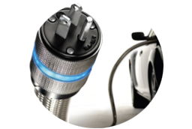

WHY DO WE NEED A SMARTER GRID?
Maximize resources to deliver higher quality, reliable power in cost-effective ways
Enhance the ability to manage diverse energy resources
Meeting electric needs for our growing population and industry
Enable new consumer technologies such as plug-in electric vehicles
Provide consumers better information and more tools to enable them to be smarter about their energy use

Slide 3
WHY DO WE NEED A BETTER GRID?
Maximize resources to deliver higher quality, reliable power in cost-effective ways
Enhance the ability to manage diverse energy resources
Meeting electric needs for our growing population and industry
Enable new consumer technologies such as plug-in electric vehicles
Provide consumers better information and more tools to enable them to be smarter about their energy use

Slide 4

HOW ARE WE PLANNING FOR THE FUTURE?
Working together to answer the right questions today about how to create innovative and cost-effective solutions to meet our customers’ needs for many years to come…
What if…?

